Slide 1
Section 5. What could we do about diagnostic quality in our hospital?
Notes:
o This is Section 5 of the toolkit, “What could we address in our hospital?”.

Slide 2
What Could we Work on Here?
Notes:
o In previous sections we have talked about patient and family engagement, the diagnostic process and how diagnostic errors occur, about some of the practices that patients, clinicians, and hospitals can use to try to maintain diagnostic quality and we’ve talked about your own personal experiences with diagnosis—whether good or bad. Let’s shift our focus now to what we as a PFAC may want to address in terms of diagnostic quality and safety at our own institution.

Slide 3
Ideas from the Group
Notes:
o At this point, you’ve all shared some of your personal experiences—whether good or bad--so you may already have some specific ideas for diagnostic quality or safety projects based on those events. During our prior sessions, some of you have already mentioned topics or ideas for projects and I’m sharing those here.
o Show, either on a slide that has been pre-populated, or on the flip-chart, whiteboard, chalkboard, or something similar, any of the ideas for projects, problems to tackle, or topics to address from the prior sessions.
o Is there anything based on what is captured here that we could imagine working on together as a PFAC? Or does anyone have additional ideas for the types of things we may want to do?
o Pause and allow for people to offer ideas; capture any additional ideas on an editable slide or on a flip-chart, whiteboard, chalkboard, or something similar. Let the discussion go on as long as 7 or 8 minutes, but move on as soon as ideas or conversation winds down. If no one speaks up, point out some of the ideas provided in prior sessions and ask the group for their interest in those, and/or provide some prompts to get other ideas or discussion flowing such as;
“For example, is there a way to get clearer guidance about “next steps” after a discharge from the emergency room? Or, can staff provide pamphlets or online information to help explain a new diagnosis?”. Allow the conversation to go on for 5-6 minutes, capturing any ideas or topics that arise.
o Thanks so much for your ideas and thoughts. We are going to talk about other ways to identify projects or activities on the next slide, and we will continue brainstorming as we go.

Slide 4
Learning About our Own Hospital
What are the opportunities to be involved in safety and quality activities?
What are the current quality or safety concerns?
Who from the hospital would be able to talk with us?
Notes:
o There may be work related to diagnostic quality ongoing at our hospital. We just need to identify the right information or the right people with whom to connect in hospital leadership. For example, what are the opportunities to be involved in safety and quality activities? What are the current quality or safety concerns? Who from the hospital would be able to talk with us?

Slide 5
What Are the Sources of Information Available?
Hospital Consumer Assessment of Healthcare Providers and Systems (HCAHPS)
Patient Relations Department or Patient Ombudsman
Hospital Risk Management or Patient Safety Office
Other people or information
Notes:
o Hospitals have different ways to track the quality of care being provided, collect information from the patients and families who are served by the hospital, and respond if some kind of safety event has occurred.
o One method to collect this information is via a survey provided to patients who have been hospitalized, to understand what their experiences in the hospital. This Survey is called the Hospital Consumer Assessment of Healthcare Providers and Systems, or “H-caps” for short. The HCAHPS survey may reveal opportunities to improve quality or safety of care—including quality and safety of diagnosis. For example, if a frequent theme in the survey information is that people are confused about what they need to do after they are discharged from the hospital, a PFAC could consider working on a project to help make the process easier and clearer for patients being discharged.
o Another potential source of information is the patient relations department or patient ombudsman at the hospital. Different hospitals call this function different things, but these are the people dedicated to talking to patients and families about concerns, complaints, or suggestions about the care being provided in a hospital. These interactions may happen during an episode of care—while a patient is still in the hospital—or they may be after the fact. In either case, learning from the experiences the patients or families share can be another source for identifying potential projects or opportunities for a PFAC. For example, if a patient had a difficult time getting a diagnosis during their hospital stay, but later learned that the medical team had a good idea of what the issue was—it just hadn’t been communicated to the patient or family, that could be an opportunity to develop more effective communication practices, to make sure patients and families know what the medical team thinks is going on, and understands what the plan is for dealing with the diagnosis.
O Information may also be available from the folks at the hospital who directly manage safety or “risk”; these are people who evaluate the systems and practices at the hospital to work to ensure they are as safe as possible. They also get involved when a safety event occurs and a person is harmed. Some of the information this group of people deals with may be confidential or unavailable to share for a number of reasons, but this may be another potential source for insights about what diagnostic quality and safety topics a PFAC may want to address.

Slide 6
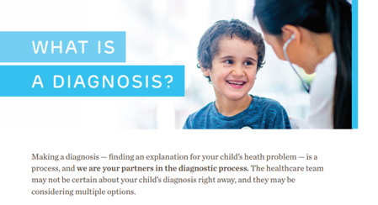
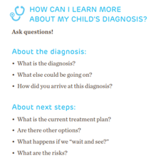
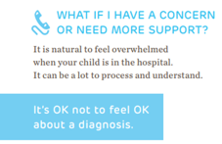
Examples of PFAC Work in Diagnostic Quality
At Children’s Hospital of Philadelphia
Reviewed feedback from hospital patient surveys
Co-developed resource for admitted patients based on the needs identified in survey
Notes:
o For example, at Children’s Hospital of Philadelphia, the PFAC partnered with hospital team members to look at their HCAHPS data—HCAHPS is the survey we just learned about that people who have been discharged from the hospital receive. They noticed that many people reported being confused or feeling a little lost during their hospitalization, not knowing what to expect while a diagnosis was being sought. Based on this information, the PFAC partnered with the hospital team members to develop a guide for people being admitted to the hospital. The guide explains the diagnostic process, equips patients and families with good questions to ask, strategies for accessing important information, and guidance for what to do if they have concerns or worries during the hospital stay. The guide has just recently been implemented, and now the PFAC will partner with the hospital team members to evaluate how effective the tool is.

Slide 7
Examples of PFAC Activities in Diagnostic Quality: Sepsis Awareness Campaign at Medstar Health
Notes:
o Another example can be found at Medstar Health, a large health system in the northeast, where patients and families got involved in an awareness and education campaign about sepsis. People who had been affected themselves, or even lost loved ones to sepsis, which is the body’s overwhelming and serious response to infection, helped develop the messaging and materials—including the video that you see in the screenshot here—to urge patients and families to say the words “I suspect sepsis” when they come to the emergency room with signs or symptoms of this serious condition. Sepsis can be very hard to diagnose because the symptoms can be vague or mimic symptoms from other conditions. By suggesting that the diagnosis may be sepsis, it ensures that sepsis makes it on to the list of differential diagnoses—you may remember that step in the diagnostic process map we reviewed in a prior session—when the clinician or team of clinicians considers what the most likely diagnoses may be. After implementing the campaign, the health system saw a decline in deaths related to sepsis, which is a sign that it is being caught earlier and diagnosed sooner, when it is more likely to be effectively treated and save a patient.

Slide 8
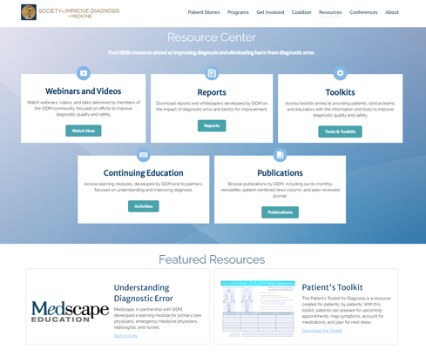
Borrowing from What Others Have Done
Notes:
o In fact, because other PFACs have done work on diagnostic quality in their institutions, we may be able to learn from what they’ve done or even implement their ideas here.
o Many challenges or concerns faced by patients and families are the same, no matter where they are located, so some of the issues tackled by other PFACs may be relevant and valuable to us.
o In the supplemental materials section of the toolkit, additional examples of PFAC activities are listed. Also, the Institute for Patient and Family-Centered Care or IPFCC, posts examples of successful PFAC initiatives on its website. The Society to Improve Diagnosis in Medicine also highlights effective tools and materials that may be worth considering. Everyone is encouraged to be on the lookout for good ideas from these organizations and other sources.

Slide 9
Determining Next Steps for PFACs
Invite safety or risk personnel to a meeting
Notes:
o Please note that in the next few slides, there will be two versions of text to choose from, depending on whether you and/or the PFAC already have relationships with relevant hospital team members. If you already have relationships with relevant hospital team members, your language will be in italics. If you need to form relationships with relevant hospital team members, your language will be in bold.
o Let’s think for a bit about what next steps we can take to (start forming/tap into the) relationships with people in our institution who work on safety and risk.
o One way to (start/strengthen) that relationship is to invite risk or safety personnel to one of our meetings; in the supplemental materials of this toolkit, there is a template for an email or letter to invite safety or risk personnel to join us for a discussion, and a suggested agenda and slide deck for that meeting.

Slide 10
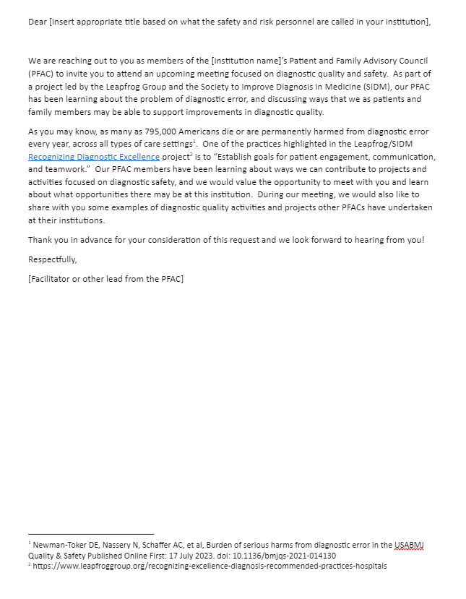
Template Letter
Suggested Agenda
PFAC members share any experiences they have had with diagnostic error
PFAC shares examples of other PFACs working on diagnostic quality
Hospital representative is asked to share:
How diagnostic quality and safety are handled (what processes or systems are in place?)
What type of information is available for the PFAC to see (such as HCAHPS data)
If they have any ideas for a project or topic the PFAC could take on?
Notes:
o On the left is a screenshot of the invitation letter (we would use/we would modify a bit based on our existing relationship) and on the right are some of the suggested agenda items from the slide deck in the supplemental materials. We would want any of our own PFAC members who feel comfortable doing so, to share any experiences they have had with diagnostic error or any of the concerns or questions they have, and then share some examples we’ve learned in this toolkit about what other PFACs have done to improve diagnostic quality at their institutions.
o We would want to ask hospital team members how diagnostic quality and safety are handled here--what processes or systems are in place, and what type of information is available for us to see (such as HCAHPS data)? We would also want to know if they have any ideas for a project or topic we could take on.
o Please note that if the hospital team members offer ideas for projects or issues to tackle, you want to capture those and save them; in Section 6 you will be reviewing all of the project and topic ideas that have been mentioned during these sessions, and narrowing down to find the one project the group wants to work on first.

Slide 11
Determining Next Steps for PFACs
Invite safety or risk personnel to a meeting
Share diagnostic error information with hospital leadership
Notes:
o Sharing information about diagnostic quality and safety—and diagnostic error--with hospital leadership is also a good idea. As we discussed earlier, we would share some of the information during our meeting with them, but distributing resources or high-level information in advance of the meeting could be helpful as well. In the supplemental materials section of the toolkit, there are a number of resources that may be helpful to share.

Slide 12
Determining Next Steps for PFACs
Invite safety or risk personnel to a meeting
Share diagnostic error information with hospital leadership
Invite safety or risk personnel to join the PFAC
Notes:
o As you can see here, it is a best practice to have folks from the hospital team who focus on quality and safety serve permanently on the PFAC. We could consider asking some of these individuals to join our PFAC/in our case, we already have those types of people serving on our PFAC so we are on the right track.

Slide 13
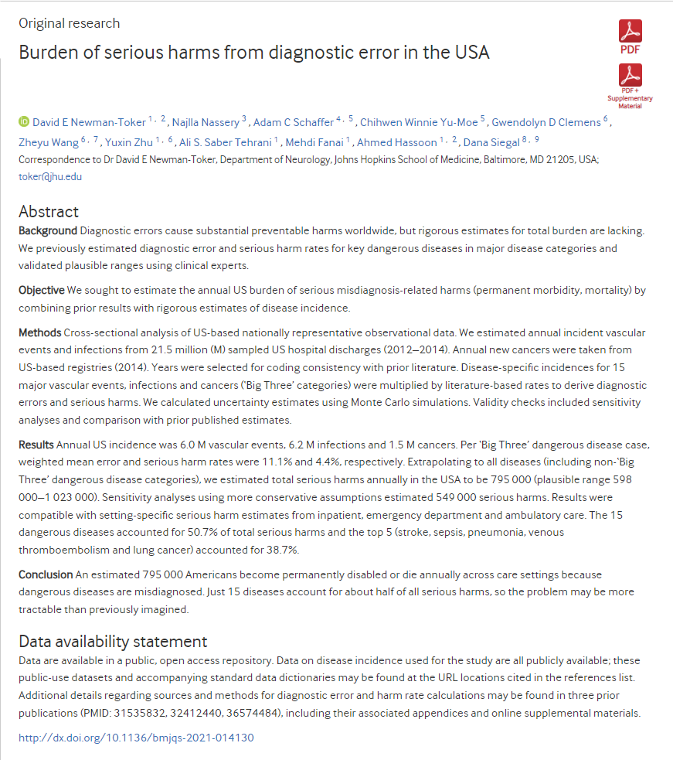
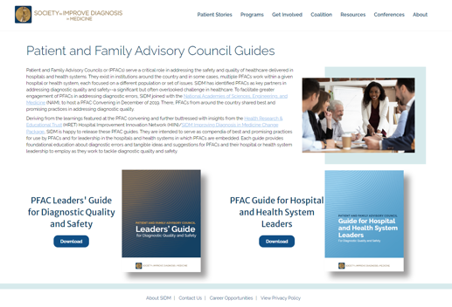
Supplemental Materials
Notes:
o Two key resources provided in the supplemental materials are this article by a leading diagnostic quality researcher that outlines our best estimates at how many people are affected and harmed by diagnostic error, and a pair of guides developed by the Society to Improve Diagnosis in Medicine—they go into a great deal of detail about how PFACs and other patient and family partners can contribute to promoting diagnostic safety at a hospital. One guide is directed at PFACs themselves and the other is directed at hospital leadership. Both resources, in addition to many others, are available in the supplemental materials at the end of the toolkit.

Slide 14
Let’s Review What We’ve Discussed
Possible diagnostic quality activities at this hospital
Examples of diagnostic quality projects by other PFACs
Importance of partnership with hospital leadership and other teams
Notes:
o In this section, we discussed what we might be able to do to address diagnostic quality in our own institution. We reviewed some examples of successful efforts by other PFACs and discussed the possibility of adopting or learning from some of those projects. We also discussed the importance of partnering with the safety and risk personnel of the hospital to be able to learn more about how diagnostic quality is managed now, and what opportunities for projects or activities might be.

Slide 15
Thank You!
Notes:
o Thank you so much for your time and participation—this was a great and productive discussion! In the next section, we will continue to explore possible activities for us to undertake and look at some practical tools and resources for moving a project or idea forward.

