Slide 1
Section 3. Understanding the Diagnostic Process and Diagnostic Safety
Part Two: Introduction to Diagnostic Error
Notes:
o This part of section 3 is and Introduction to Diagnostic Error.

Slide 2
Understanding Diagnostic Error
When Diagnostic Error Occurs
Delayed, wrong,
or missed diagnosis
Diagnosis not communicated
At least one missed opportunity to find the correct diagnosis in a timely manner, based on the information available at the time.
The right diagnosis was identified, but not communicated or not communicated in an understandable way to the patient or family.
Notes:
o In the last section, we learned all about the process of diagnosis and what can help diagnosis to be accurate and timely; now we’re going to shift gears and talk about what happens when that process goes wrong.
o Let’s start with the basic definition of a diagnostic error. This definition came from the Leapfrog and Society to Improve Diagnosis in Medicine’s Recognizing Diagnostic Excellence Project which explains that diagnostic error is an event where one or both of the following occurred, with harm or high potential of harm to the patient: Delayed, wrong, or missed diagnosis: At least one missed opportunity to pursue or identify an accurate and timely diagnosis based on the information that existed at that time and/or Diagnosis is not communicated to the patient: Accurate diagnosis was available but was not effectively communicated to the patient or family.
o Let’s pause for a minute…first, any questions about this definition?
o Allow 2-3 minutes for questions or discussion.
o Does anyone have examples or experiences with diagnostic error they want to share—these could be your own or those of your loved ones? Please avoid using the names of any providers or hospitals/institutions where the errors occurred.
o Allow 2-3 minutes for discussion.

Slide 3
Factors that Lead to Diagnostic Excellence
ACCURATE
TIMELY
COMMUNICATED
Notes:
o One way to learn about diagnostic error is to start by thinking about what makes a diagnosis “good”, and then flip those qualities. A simple way to think about a “good” diagnosis is that it was accurate (it needs to be the right diagnosis), timely (it should be identified as soon as possible), and communicated in a way the patient and family can understand. Even if a diagnosis is accurate and timely, if it is not communicated to the patient or family in a way they can understand and take action, the patient can still be harmed.

Slide 4
“The Missed Test”
Julia Berg
Excerpted from the Society to Improve Diagnosis in Medicine’s Patient Story Bank at https://www.improvediagnosis.org/stories/
Notes:
o Let’s spend a little more time on each of these pieces by learning from some of the patient stories in the Society to Improve Diagnosis in Medicine’s Patient StoryBank. This is a resource for patients or family members to share their diagnostic error story so that others can learn from their experiences and use them as teaching tools.
o Julia Berg’s story is an example of how important the accuracy of the diagnosis is. She was a perfectly healthy 15 year-old, who began to feel under the weather, experiencing a sore throat, lethargy, and a fever. Initially diagnosed with and treated for a kidney infection, a few days later she was diagnosed with a gallbladder infection, placed on a liquid diet, and scheduled for surgery but low platelet counts meant the surgery kept getting pushed back. Throughout their time in the hospital Dan and his wife noted how many clinicians seemed puzzled by the diagnosis in such a healthy and fit young woman. Eventually the surgery occurred as planned, but four hours after the surgery, Julia coded and died—from complications of an undiagnosed case of mononucleosis—or, mono.
o Julia’s parents, Dan Berg and Welcome Jerde became very active in diagnostic quality after the loss of Julia, including using Julia’s story as a teaching tool for students at their local medical school and hosting educational events in her honor. Dan is also very active as a volunteer with SIDM.

Slide 5
“The Delayed Diagnosis”
Chad Becken
Excerpted from the Society to Improve Diagnosis in Medicine’s Patient Story Bank at https://www.improvediagnosis.org/stories/
Notes:
o Susie Becken lost her son Chad to a delay in diagnosis of his colorectal cancer.
o Chad sought care for an array of worrisome symptoms including low back pain, fatigue, and weight loss. He was seen by a number of clinicians, some of whom ran tests, but none of them provided answers. By the time Chad, who was 36 years old, was advised to get a colonoscopy, it was too late. He was diagnosed with stage 4 colorectal cancer, and the tumor had penetrated the pelvic wall making removal of the tumor impossible. Chad did undergo treatment for several months, but tragically died at the age of 37.
o After the loss of Chad, Susie became very active in the patient safety movement, serving on her local Patient and Family Advisory Council, and partnering with SIDM on a number of diagnostic quality projects.

Slide 6
“The Undisclosed Diagnosis”
Steven Coffee II
Excerpted from the Society to Improve Diagnosis in Medicine’s Patient Story Bank at https://www.improvediagnosis.org/stories/
Notes:
o And lastly, Steven Coffee II’s rare metabolic disorder was not explained to his family.
o Col. Steven Coffee's son was born premature, with low glucose and high bilirubin levels, and an issue with throwing up milk, but he and his wife were assured these things were not too alarming given that he was premature. Within a month of his birth however, he was diagnosed with galactosemia, a rare metabolic disorder that makes someone unable to process galactose—a component of milk. Despite being told that the baby had the condition, the family was not made aware what the condition was or how to manage it. Ultimately, complications of the condition caused the baby to develop fulminant liver failure and require a liver transplant. Now a healthy young man, these severe complications could have been avoided with clearer and more accessible information about the diagnosis.
o After his son’s experience, Col. Coffee became a very vocal patient advocate, serving as a member of his nearby PFAC, partnering with SIDM on a number of projects, and co-founding with several other advocates Patients for Patient Safety, US, an affiliation of the World Health Organization.
o Does anyone have any questions or comments about these stories?
o Allow 2-3 minutes for questions or discussion.

Slide 7
Diagnostic Error Statistics
One in 20 patients in outpatient settings will experience a diagnostic error = 12 million Americans annually
Patients experiencing medical errors report misdiagnosis more often (59%) than any other error
Across care settings ,roughly 795,000 , people are permanently disabled or die each year from diagnostic failures
Estimates of the costs associated with diagnostic error exceed $100 billion per year
Sources: “Improving Diagnosis in Healthcare” National Academy of Medicine 2015 report, Newman-Toker DE, Nassery N, Schaffer AC, et al. BMJ Qual Saf Epub ahead of print:doi:10.1136/
Bmjqs-2021-014130, Newman-Toker DE, Schaffer AC, Yu-Moe CW, Nassery N, Saber Tehrani AS, Clemens GD, Wang Z, Zhu Y, Fanai M, Siegal D. Serious misdiagnosis-related harms in malpractice claims: The "Big Three" - vascular events, infections, and cancers. Diagnosis (Berl). 2019 Aug 27;6(3):227-240. doi: 10.1515/dx-2019-0019. Erratum in: Diagnosis (Berl). 2020 May 16;8(1):127-128. PMID: 31535832.
Notes:
O This slide provides some of the most recent facts and figures on the diagnostic errors in the United States. As you can see, 1 in 20 patients will experience a diagnostic error in the outpatient setting each year, and among all of the types of medical errors, patients and families report diagnostic errors more than other types of errors.
O Across all types of care—including care provided in the hospital—as many as 795,000 people are made permanently disabled or die due to diagnostic errors each year, and diagnostic errors are estimated to cost over $100 Billion annually.

Slide 8
Avoiding Diagnostic Challenges
Effective Teamwork
Reliable Diagnostic Process
Engaged Patients & Family Members
Optimized Cognitive Performance
Robust Learning Systems
1
2
3
4
5
KEY DRIVERS
Notes:
O As we learned in the last section, there are a number of things that hospitals and clinicians do to support accurate and timely diagnosis; this is the diagram we reviewed that outlines five “key drivers” for diagnostic quality and safety. As you think about the examples we’ve worked through, which of these drivers do you think may have broken down?
O Allow for a few minutes of discussion before moving to the text below and then on to the next slide.

Slide 9
Supporting Patients and Families through the Diagnostic Process
Notes:
o There are also resources to help patients and families through the diagnostic process, helping them prepare for appointments, track symptoms, and try to best navigate what may be a complicated process.
o One of these resources was created by patients on the Patient Engagement Committee of the Society to Improve Diagnosis in Medicine, called the Patient’s Toolkit for Diagnosis—these patients had experiences with diagnostic errors themselves. This toolkit is accessible on SIDM’s website and we’ll go through it together over the next few pages.
o This first page, as you can see, is the instructions for how to use the toolkit. It explains that the toolkit should be filled out prior to a visit, to help the patient best partner in their care, provide the most relevant and important information to the clinical team, and keep track of what happens during and after the visit.

Slide 10
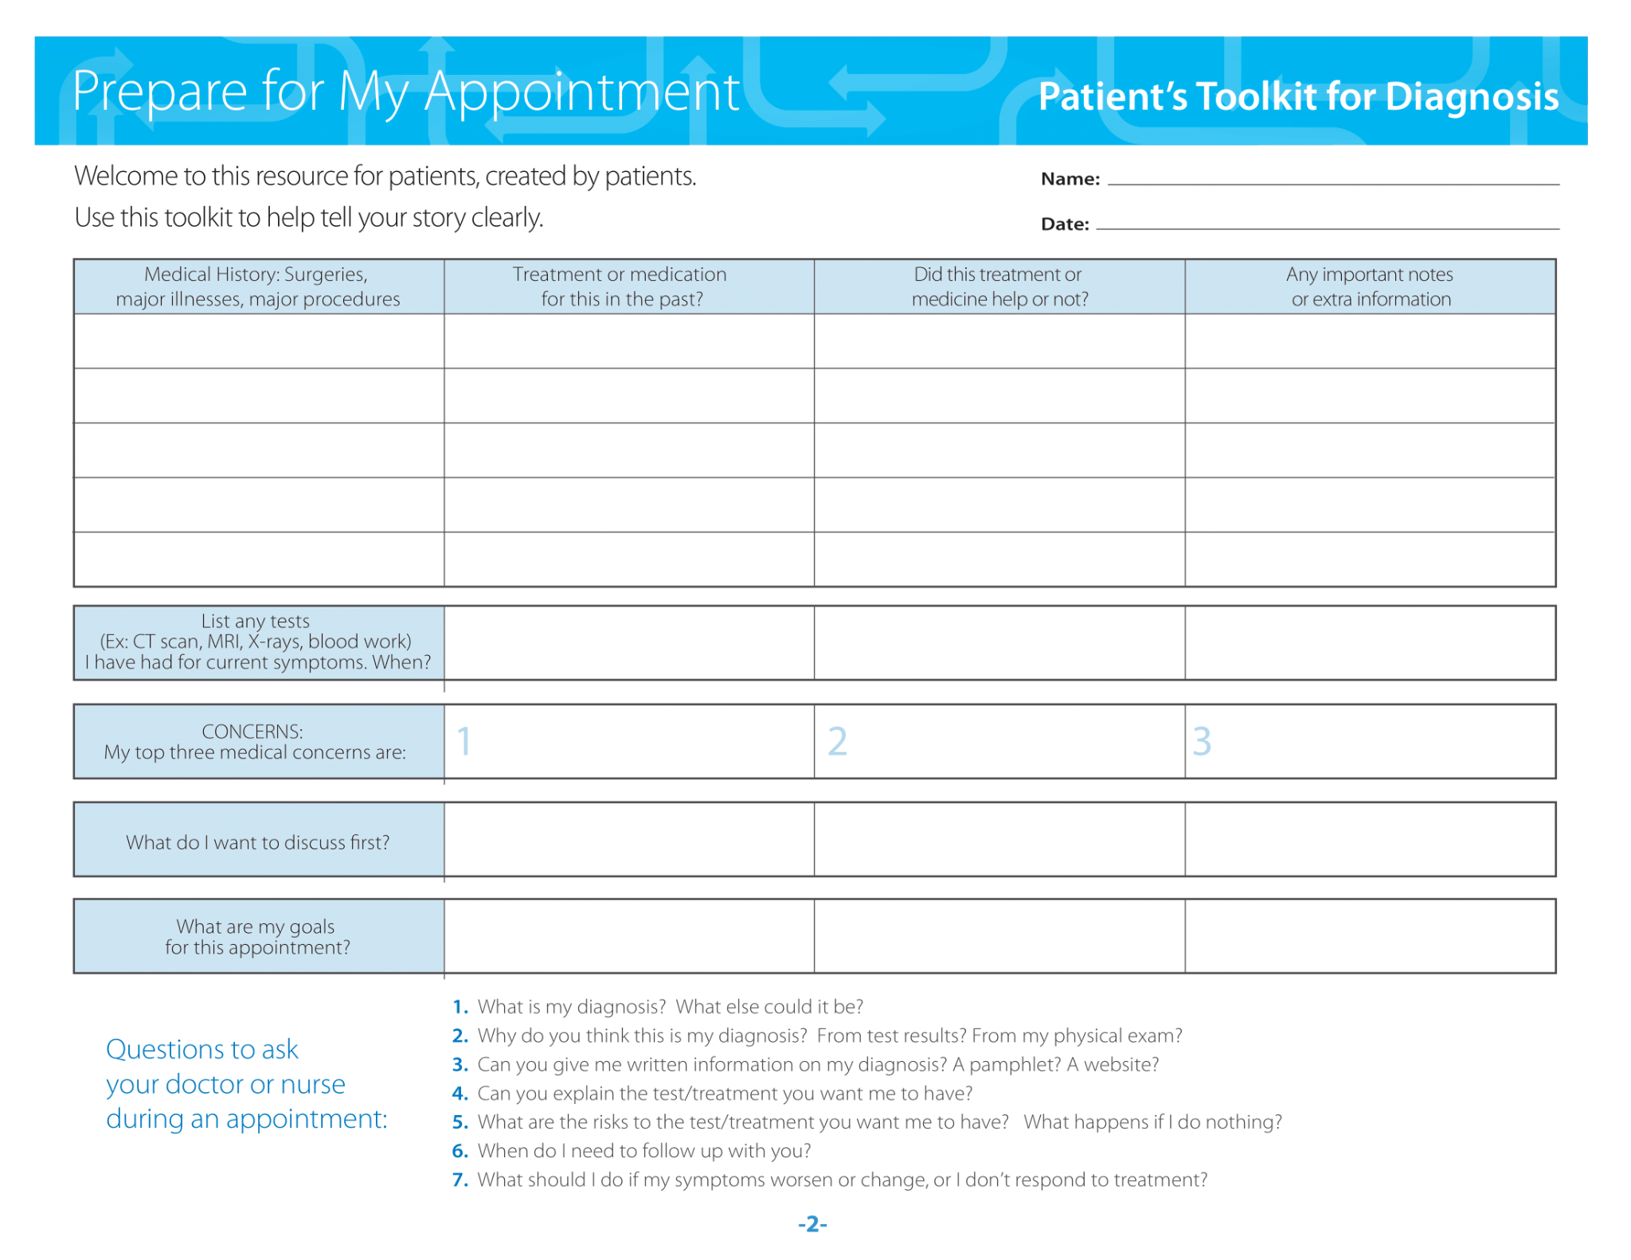
Supporting Patients and Families through the Diagnostic Process
Notes:
o This first page is focused on preparing for medical appointments; as you can see, information is broken into several sections, and the idea is to spend time gathering and entering the information before your clinic visit.
o One of the most important suggestions in the toolkit is the list of questions at the bottom of this page; these are ideas for questions patients/families may want to ask in a visit—and again, this toolkit was developed by people who have experienced problems with getting the right diagnosis, so these questions were informed by those experiences.
o Maybe most important—what is my diagnosis?
o What makes the clinical team think that is the most likely diagnosis?
o Is there more information I can access about the diagnosis?
o Are there more tests or any treatment I need—and can you explain those to me?
o Are there any risks to these tests or treatment? What would happen if I did not follow up with these tests or treatments? Would that be harmful to me?
o When do I need to follow up with you and how do I do that?
o What should I do if my symptoms change or get worse?
o Any questions or comments before we move to the next page?
o Allow 2-3 minutes for questions or discussion.

Slide 11
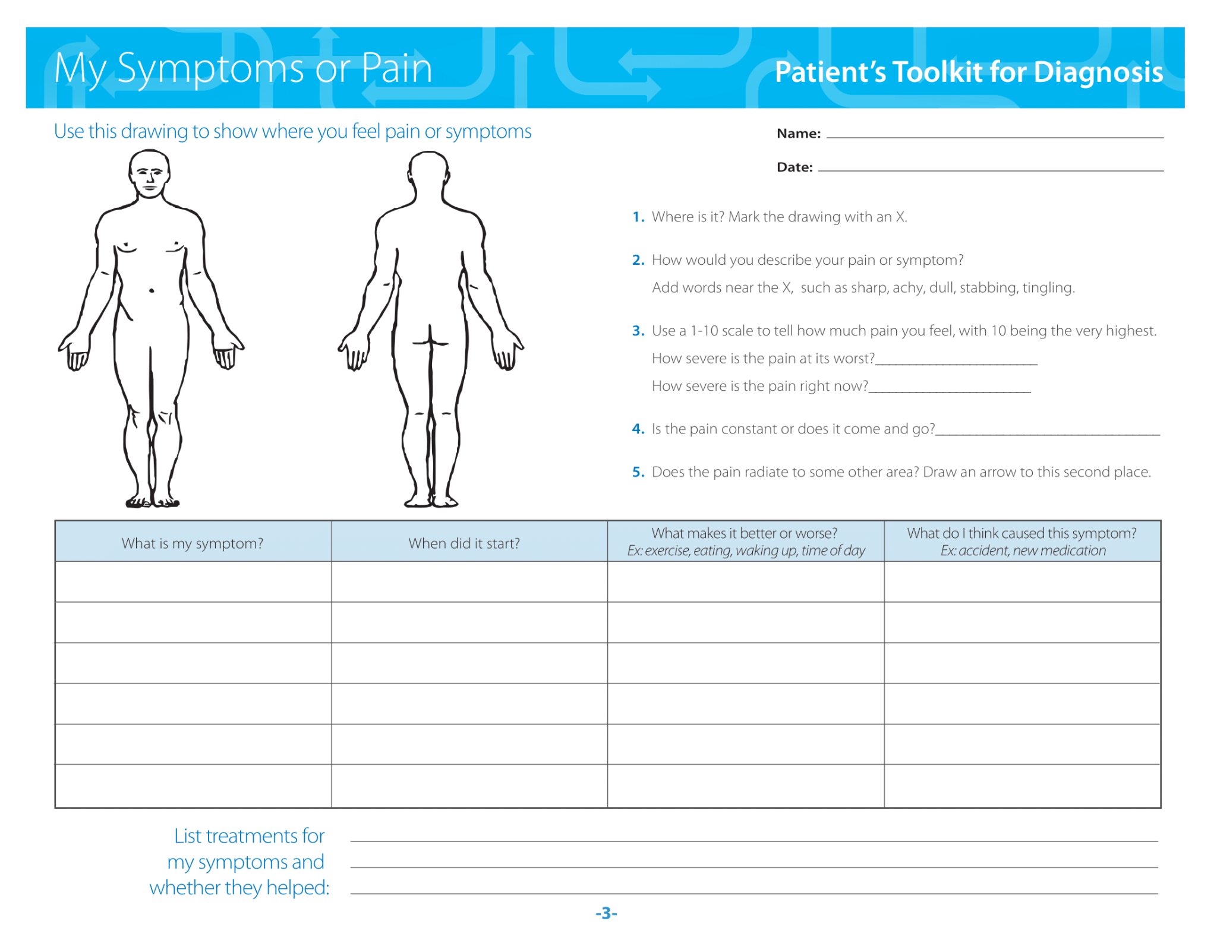
Supporting Patients and Families through the Diagnostic Process
Notes:
o Next we have a page that helps someone think through their symptoms and make careful notes about what has been going on with their health. It has a diagram of the body to allow you to note the location of symptoms; it asks questions about pain, type of pain, and severity of pain, and any ongoing treatments for symptoms.
o Any questions or comments before we move to the next page?
o Allow 2-3 minutes for questions or discussion.

Slide 12
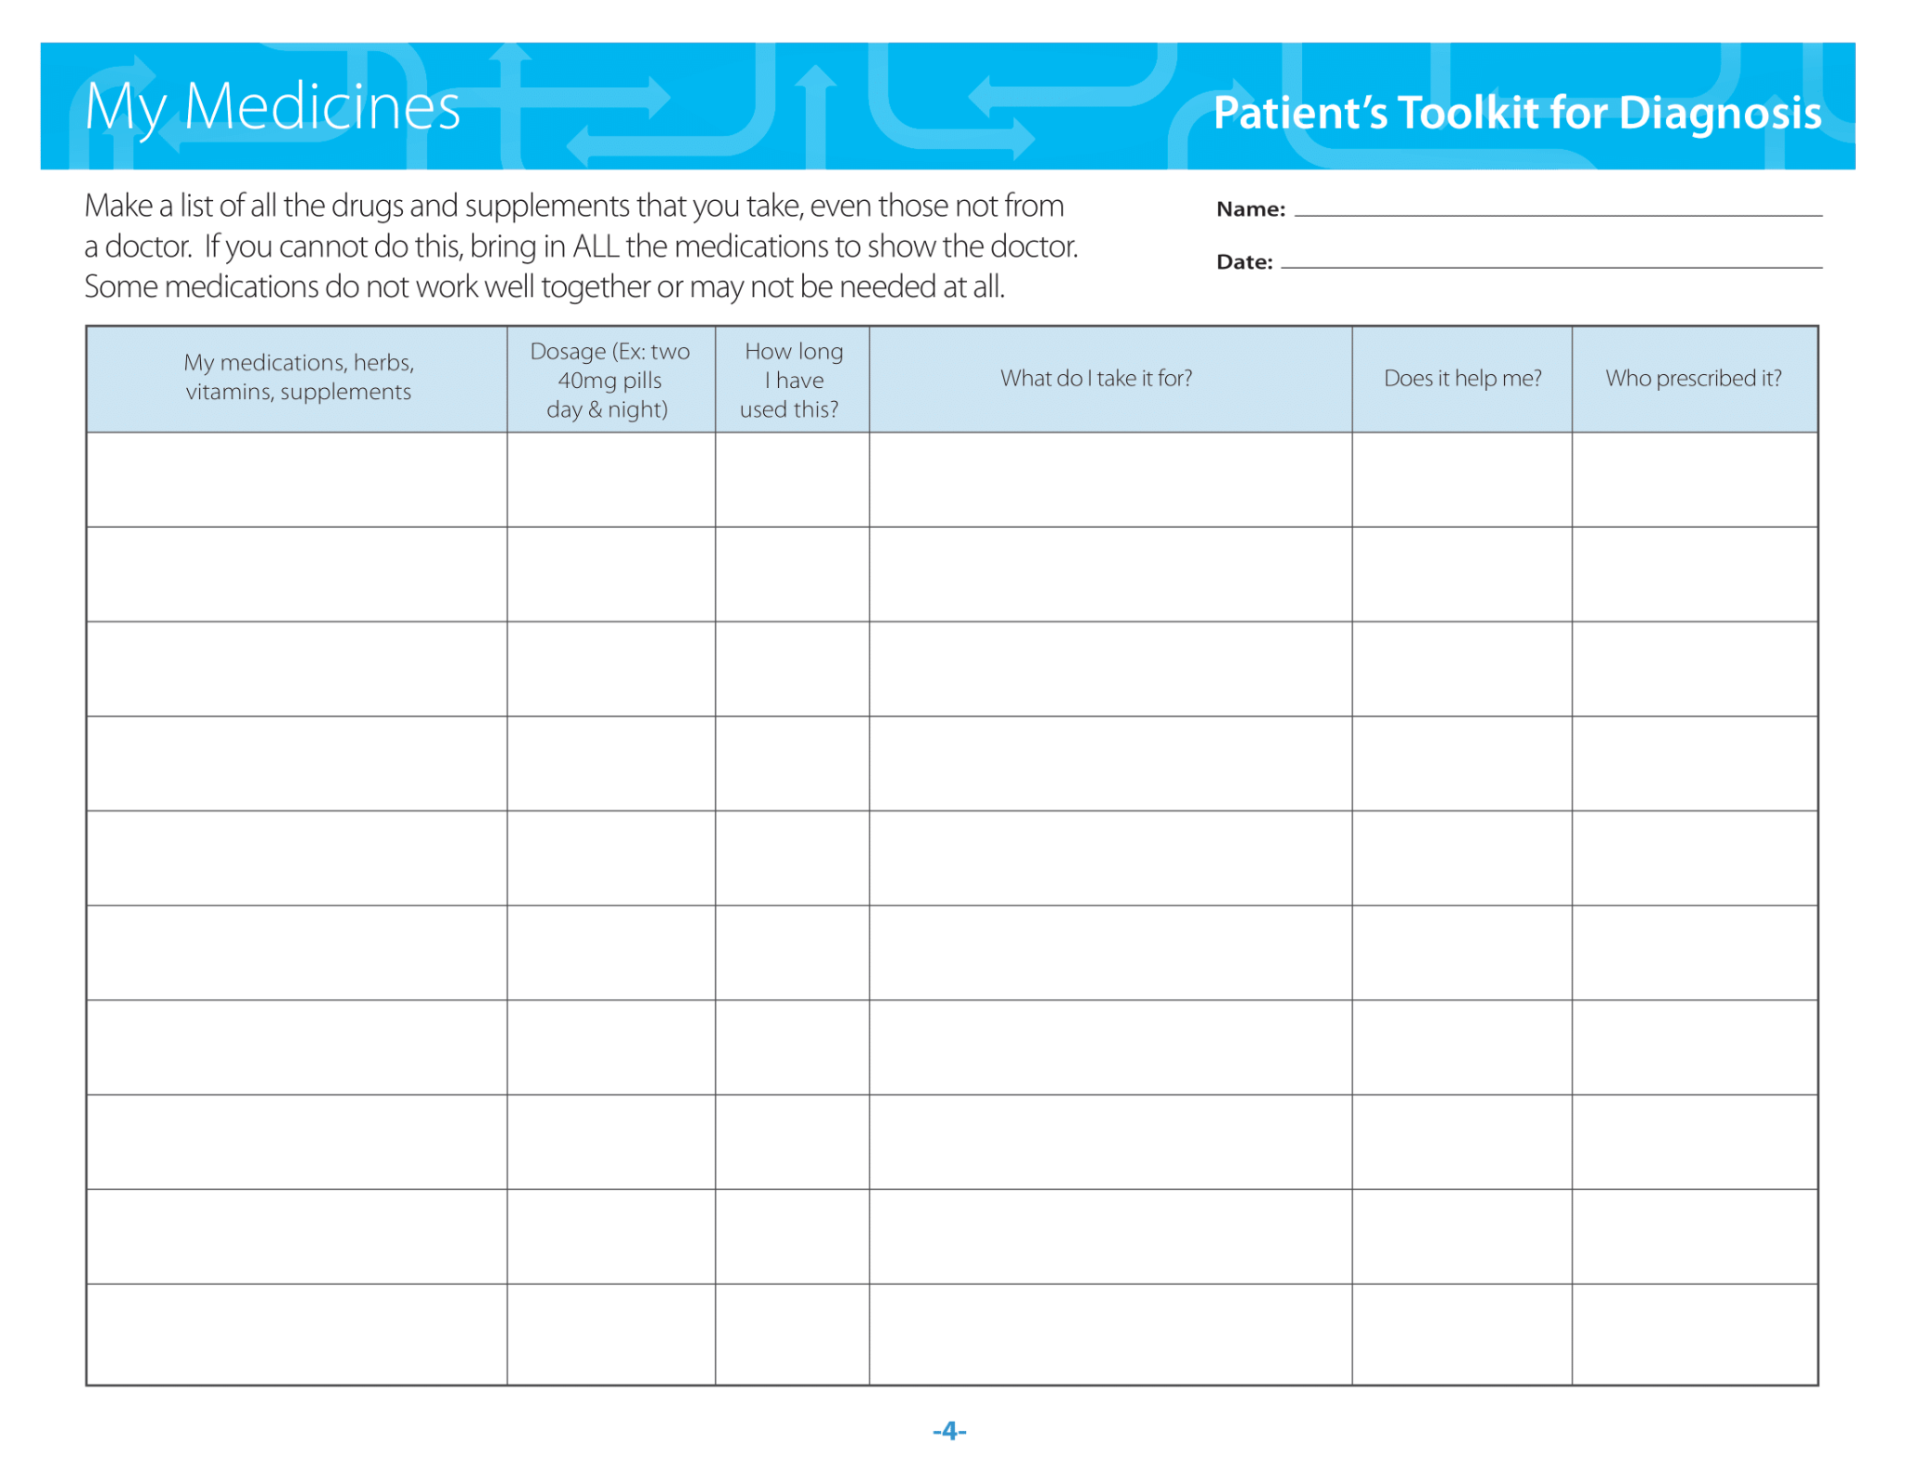
Supporting Patients and Families through the Diagnostic Process
Notes:
o As you can see, this page focuses on medication; this may seem strange at first, but when a person and their medical team is trying to get to the bottom of a medical issue, having a complete picture of all the possible issues is very helpful. Perhaps the symptoms a person is experiencing are related to a medication they are taking. Or a medication they have stopped taking.
o Any questions or comments before we move on?
o Allow 2-3 minutes for questions or discussion.

Slide 13
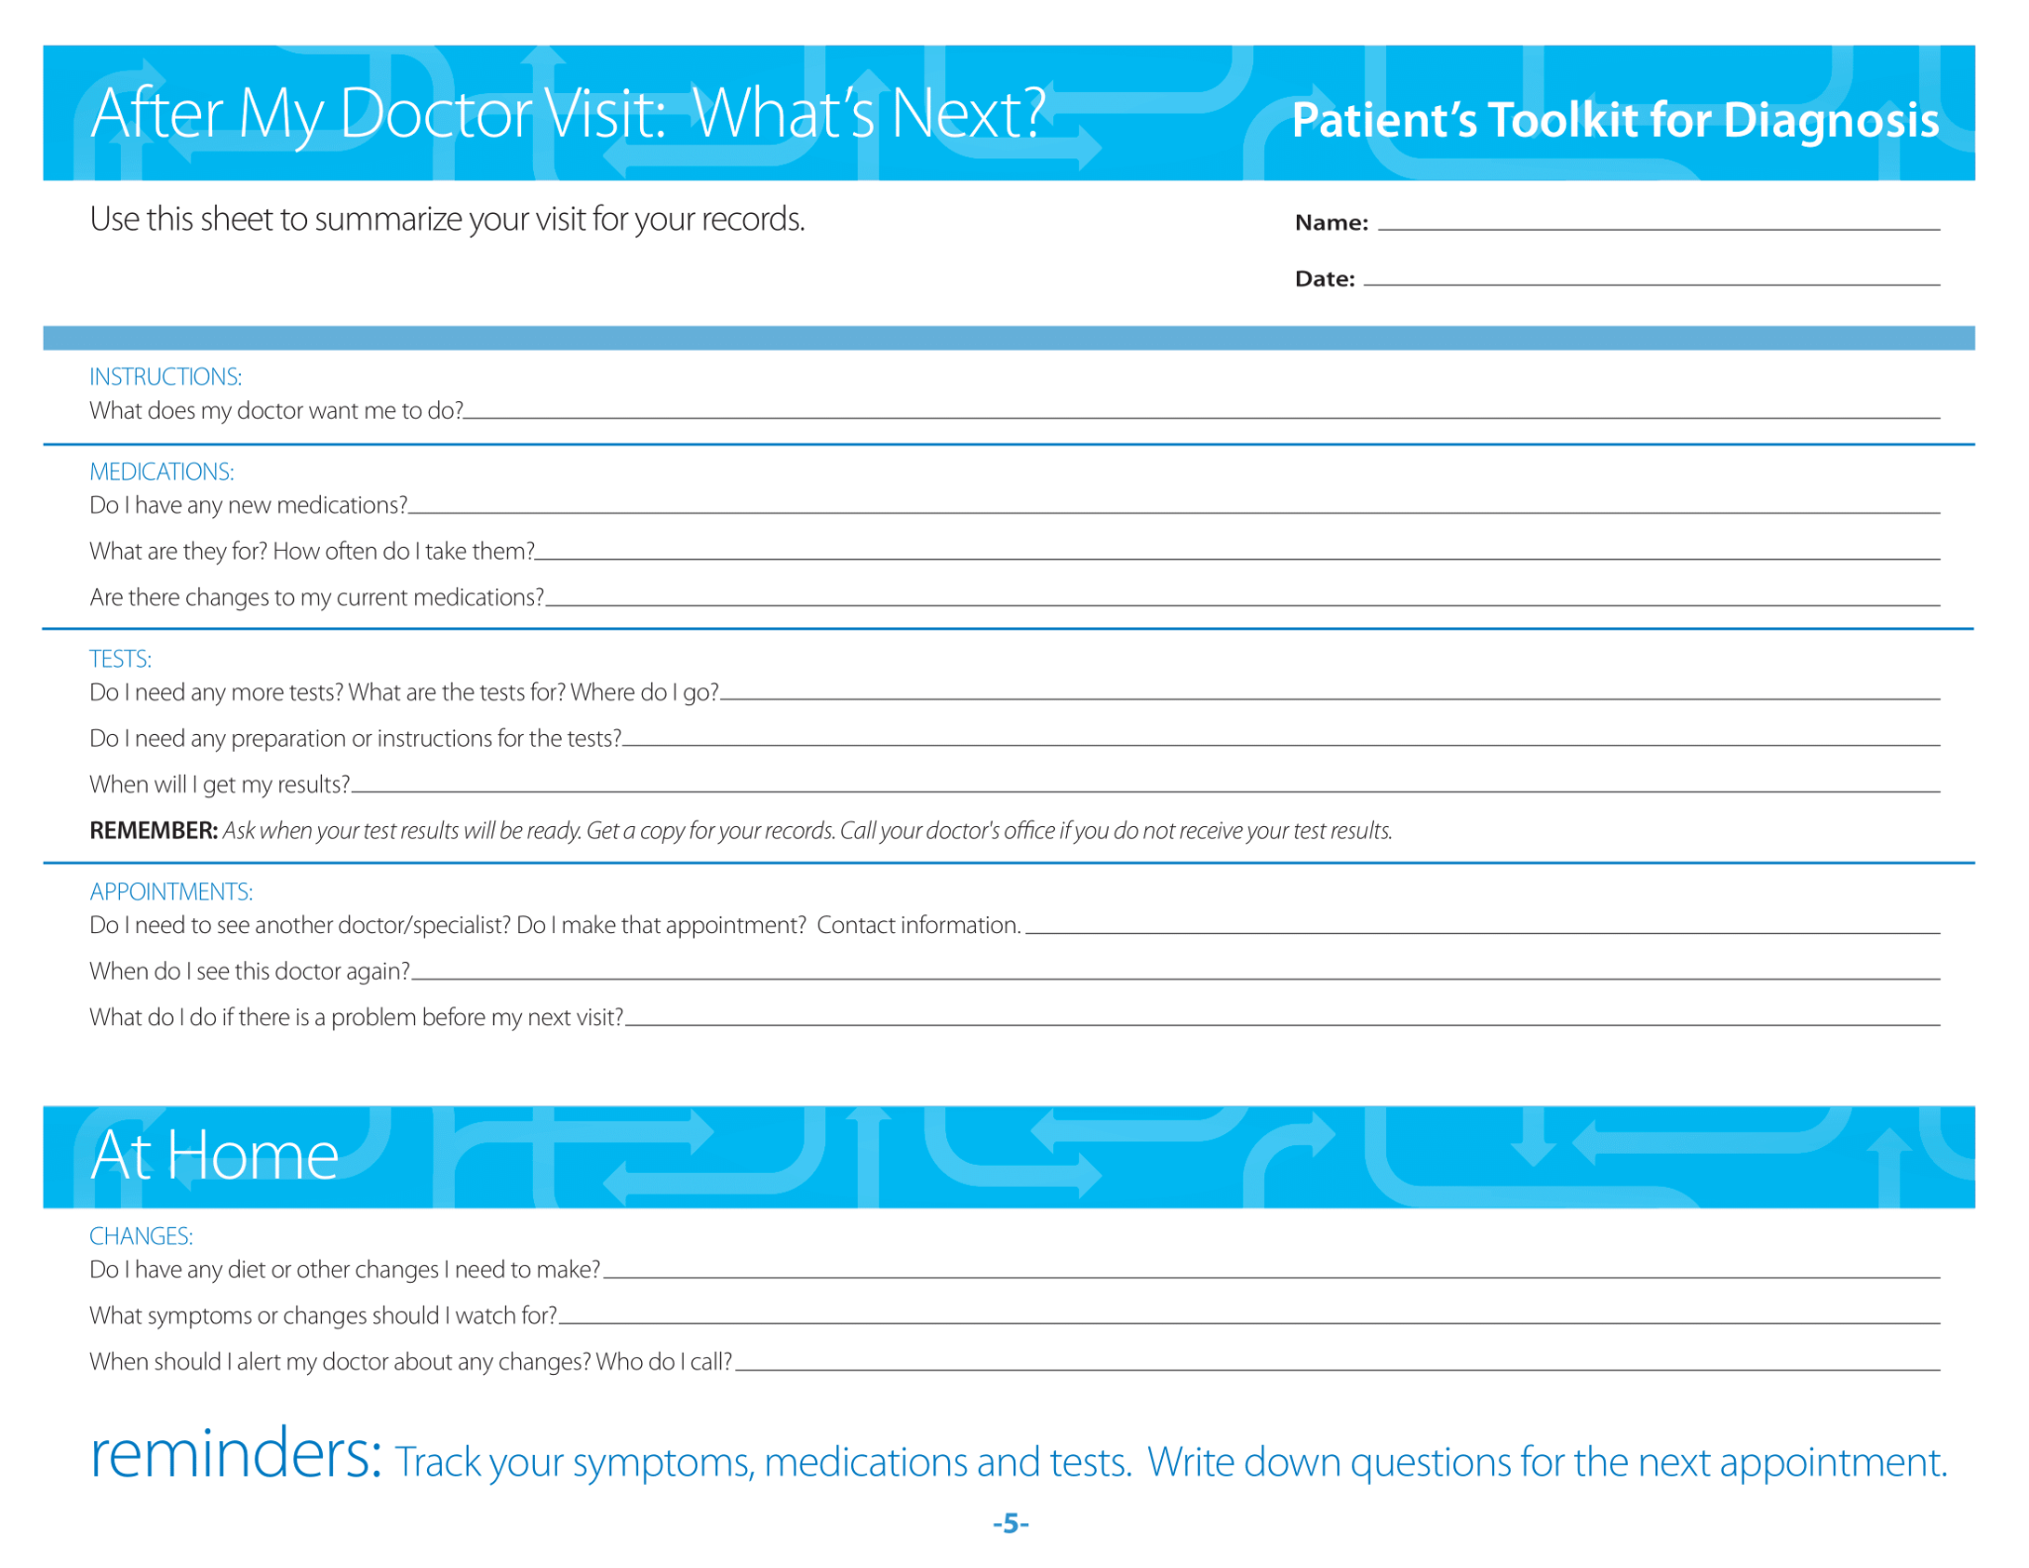
Supporting Patients and Families through the Diagnostic Process
Notes:
o And lastly, this page is focused on what happens next. This is a place to capture all of the information that was discussed or provided during an appointment, including any instructions for tests or medications. As you’ve seen now in a few of these sections, diagnosis truly is a process, and so it is important that any needed follow-up happens, including additional appointments, tests or consultations with other clinicians.
o This page covers not only what needs to happen in terms of clinical follow-ups like testing or appointments, but any changes that need to happen at home. Are you supposed to monitor your symptoms? Change any behaviors—like increase or decrease activity? Change any medications?
o This is just one such tool, but others exist as well, and those can be found in the supplemental materials available at the end of the toolkit.

Slide 14
Let’s review what we’ve discussed
The definition of diagnostic error
The frequency and prevalence of diagnostic error
Patient and family stories of diagnostic error
The role of patients and families in the diagnostic process
The Patient’s Toolkit for Diagnosis
Notes:
o Let’s take a minute to review everything we’ve just covered and shared.
o We began by discussing the definition of diagnostic error and hearing stories of families affected from missed and delayed diagnosis. We then learned the most recent data about the frequency and prevalence of diagnostic errors, and reviewed the five Key Drivers to support diagnostic quality. Lastly, we reviewed a tool for diagnostic quality that is focused on patients and families—the SIDM Patient’s Toolkit for Diagnosis.

Slide 15
Thank You!
Notes:
o Thank you so much for your time and participation—this was a great and productive discussion!
o In the next sections of the toolkit, we will be moving from the big picture of diagnostic quality and safety, to a more specific look at diagnosis at the individual level, and how we can learn from both successful and unsuccessful diagnostic experiences.

