Slide 1

Section 2. Introduction to Patient & Family Engagement
Part Two: The Role of Patient and Family Advisory Councils
Notes:
o This is the second part of Section 2, The Role of PFACs.

Slide 2

What guides successful PFACs?​
Notes:
o Over the next several pages, we will be talking and learning about how successful PFACs are able to be so effective. Let’s start by hearing from you. When you think about what would make this PFAC most effective—or what has made our PFAC effective, what comes to mind?
o Let the discussion go on for 3-4 minutes before moving to the next slide. Capture what is shared (in high level summaries) on an editable slide, chalkboard/whiteboard/flipchart. *Note that anything particularly interesting or important may be something you want to circle back to later in the Section or in later Sections, or keep on the radar for a future project. If folks are shy to talk or there are not many volunteers to speak, move to the next slide sooner. When the conversation feels like it is winding down, indicate you’re moving to the next slide and thank you them for contributing (i.e., “thank you for sharing those ideas!”

Slide 3
Patient and Family Advisory Councils’ (PFACs)
Promising Practices
The Institute for Patient and Family-Centered Care (IPFCC) plays a vital role in supporting PFACs; convening meetings, sharing resources and discussing best practices.
IPFCC has developed a list of common characteristics for effective PFACs.
At least 50% of members are Patient and Family Advisors (PFAs)
Meet regularly
(10-12 times per year)
Establish annual goals
Chair or co-chair is a PFA
Have an agenda and maintain minutes
Seek a balance of PFAC-initiated and staff-initiated projects
Have established guidelines
Provide orientation and ongoing training to members
Evaluate effectiveness of PFAC
Notes:
o The Institute for Patient and Family-Centered Care or IPFCC is an important organization for PFACs; they convene meetings of PFACs, collect and share resources, and study best practices.
o IPFCC has developed a list of common characteristics among effective PFACs, and many of them are listed here. Let’s go through these one by one.
o Go through (and read) each item and invite the group to react. Prompt with things like “Is this true of our PFAC?”, “Does this make sense for our PFAC?”, or “If this doesn’t already exist, what could we do to take some steps in this direction?”
o At least 50% of the members are Patient or Family Advisors (PFA)
o The chair or co-chair is a PFA
o They have establish guidelines
o They meet at least 10-12 times per year
o They have an agenda and keep minutes from the meetings
o They provide orientation and training to new and ongoing members
o They establish annual goals
o They seek a balance of projects initiated or started by PFAC members, and projects initiated or started by others at the hospital
o They evaluate their effectiveness

Slide 4

Being an impactful PFAC
What are you working on?​
What are you proud of?​
​What would you like to do next?
Notes:
o So we’ve talked for a little while about the characteristics that make a PFAC strong and effective, let’s shift now to the ways PFACs can have an impact.
o Invite the group to talk about what they’ve been working on—including from a historical perspective, using the three questions on the slide. Capture what is shared (in high level summaries) on an editable slide, or chalkboard/whiteboard/flipchart. Give each question 1-3 minutes and when the conversation feels like it is winding down, indicate you’re moving to the next slide and thank them for contributing (i.e., “thank you for sharing that input!”).
o Let’s think about our own activities—what are we working on?
o What are we proud of?
o What would we like to do next?
o *Note that for the last question anything particularly interesting or important may be something you want to circle back to later in the Section or in later Sections, or keep on the radar for a future project.

Slide 5

Celebrating PFAC Wins
Notes:
o Thank you for sharing your ideas and experiences; now let’s look at how other PFACs have been able to make a difference.

Slide 6


Examples of What Effective PFACs Do
At Brigham & Women’s Hospital, Boston
Partnered on a guide for patients and families being admitted
Involved in the redesign of emergency department
Notes:
o At Brigham and Women’s hospital, the PFAC has contributed to a number of initiatives, two of which are featured here. First, they partnered in the creation of a guide for patients and families being admitted to the hospital. Anyone who has been admitted knows it can be overwhelming and scary. This guide helps explain the steps and let’s folks know what options are available to them if they have needs or concerns while they’re in the hospital.
o Second, the PFAC was very involved in the redesign of the emergency department, making sure the space is as accessible and welcoming as possible, and is responsive to all of the needs of patients and families. Emergency departments can be so scary and no one knows better than patients and families who have spent time in them, how they can be enhanced to be less unsettling.

Slide 7
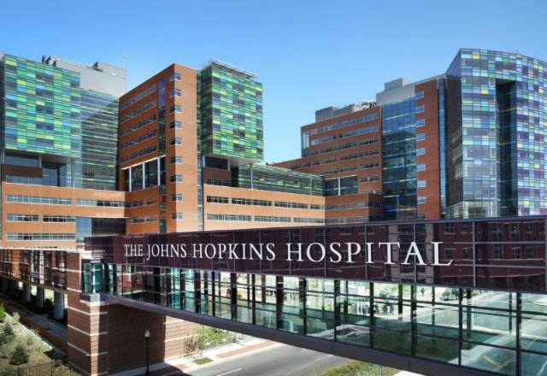
Examples of What Effective PFACs Do
At John Hopkins Hospital, Baltimore
Co-designing a research survey
Notes:
o At Johns Hopkins, a PFAC member reviewed and provided feedback on a survey used to evaluate the experience of Johns Hopkins research participants. PFAC members can be involved in any aspect of the hospital or health system’s work, including research and quality improvement.
o For more examples, please consult the “Additional Resources” on the toolkit website, as well as the IPFCC website which collects PFAC “exemplars”.

Slide 8


Reminder: Engagement Types A and B
Type A
Personal Engagement
Type B
Health System Engagement
Patients and families actively involved in efforts at the system or organizational level to improve diagnosis and care​, and overall healthcare experience.
Patients and families actively involved in their own care, diagnosis, disease management, and treatment.
Notes:
o You might remember from the last session our discussion of Type A or personal and Type B or system level engagement. This would be a good time to narrow in on WHY PFACs are such critical partners. You have all come to this “room” because you have lived experiences with the medical system—what we call Type A engagement. And now you can use that lived experience to inform efforts to improve care and safety for everyone served at the hospital—what we call Type B engagement.

Slide 9



Tools of the Trade for Diagnostic Safety
The PFAC is well connected to organizational leaders
The PFAC provides opportunities to hear from the community
The PFAC advocates for full engagement of patients and families in all hospital activities
Notes:
o As we work through this toolkit, we’ll be learning about the ways PFACs can support efforts to keep patients and families safe during the diagnostic process. For PFACs to be most successful in this type of work there are a few specific qualities that are necessary. The PFAC needs to have a strong connection and a solid relationship with the hospital leadership. The PFAC should have a strong partnership with the community of patients and families served by the hospital—including ways to collect feedback and be responsive to community needs. Lastly, the PFAC should be advocating for the involvement of patient and family partners in all activities.
o Let’s pause for a minute and talk about where our PFAC has strengths and where we might need to build some capacity—or develop relationships.
o Using the questions below, invite the group to a discussion for 3-4 minutes on each one before moving on. Capture what is shared (in high level summaries) on an editable slide, or a chalkboard/whiteboard/flipchart. *Note that anything particularly interesting or important may be something you want to circle back to later in the Section or in later Sections, or keep on the radar for a future project. When the conversation feels like it is winding down, indicate you’re moving to the next slide and thank you them for contributing (i.e., “thank you for sharing those ideas!”).
o Is there anything we need to work on in terms of our relationships with hospital leadership? What can we do?
o What has our experience been with connecting to our broader community of patients served by this hospital? What should we explore or consider?
o What have we been doing in terms of advocating for the inclusion of patient and family advocates in all of the safety and quality work of this hospital? What do we need to be doing?

Slide 10

Let’s review what we’ve discussed
The qualities of effective PFACs
Activities undertaken by other PFACs
Why PFACs are so important
Notes:
o Let’s take a minute to review everything we’ve just covered and shared. We started with talking about the qualities of effective PFACs. Next we discussed and learned about the types of activities PFACs undertake, including this PFAC’s major wins—and hopes for future activities.
o We looked at a couple of key attributes most PFACs have and what this PFAC has at its disposal, and why the work of PFACs is so important. Is there anything else anyone wants to ask or say before we close?
o Capture what is shared (in high level summaries) on an editable slide, or chalkboard/whiteboard/flipchart.

Slide 11
Thank You!
Notes:
o Thank you so much for your time and participation—this was a great and productive session!
o The next section in the toolkit is about diagnosis and diagnostic safety.

